Slide 1
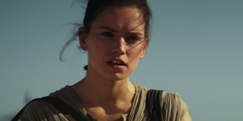
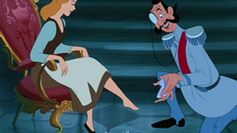
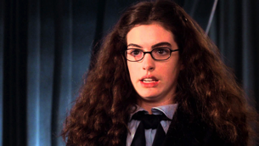
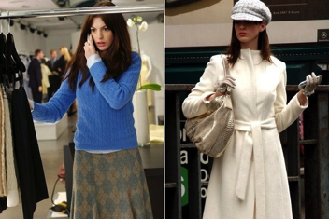
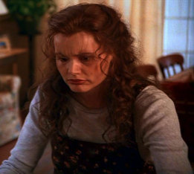
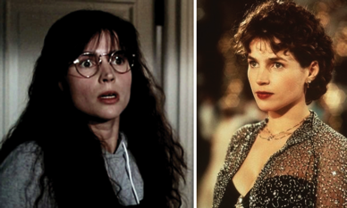
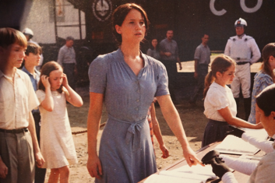
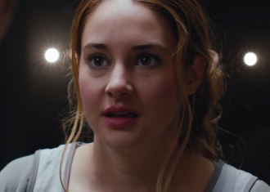
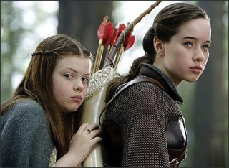

Slide 2
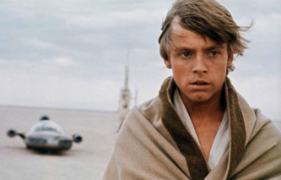
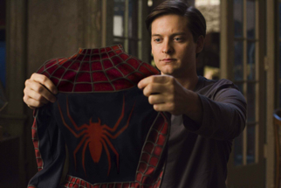
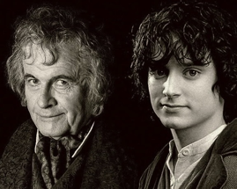
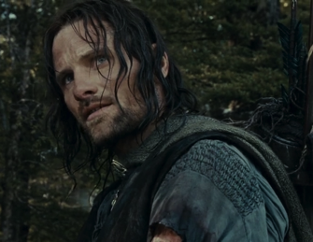
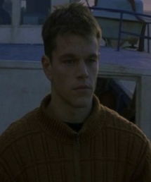
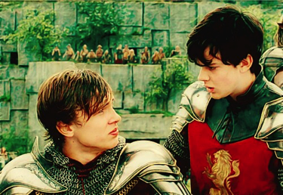
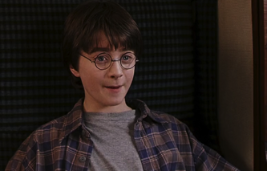
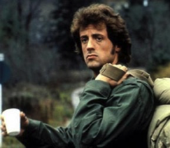
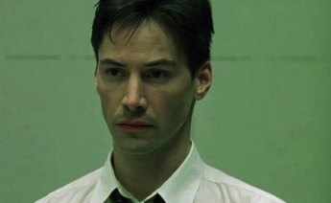

Slide 3
Genesis 3:1-13
3 Now the serpent was more crafty than any of the wild animals the Lord God had made. He said to the woman, “Did God really say, ‘You must not eat from any tree in the garden’?”
2 The woman said to the serpent, “We may eat fruit from the trees in the garden, 3 but God did say, ‘You must not eat fruit from the tree that is in the middle of the garden, and you must not touch it, or you will die.’”
4 “You will not certainly die,” the serpent said to the woman. 5 “For God knows that when you eat from it your eyes will be opened, and you will be like God, knowing good and evil.”
6 When the woman saw that the fruit of the tree was good for food and pleasing to the eye, and also desirable for gaining wisdom, she took some and ate it. She also gave some to her husband, who was with her, and he ate it. 7 Then the eyes of both of them were opened, and they realized they were naked; so they sewed fig leaves together and made coverings for themselves.
8 Then the man and his wife heard the sound of the Lord God as he was walking in the garden in the cool of the day, and they hid from the Lord God among the trees of the garden. 9 But the Lord God called to the man, “Where are you?”
10 He answered, “I heard you in the garden, and I was afraid because I was naked; so I hid.”
11 And he said, “Who told you that you were naked? Have you eaten from the tree that I commanded you not to eat from?”
12 The man said, “The woman you put here with me—she gave me some fruit from the tree, and I ate it.”
13 Then the Lord God said to the woman, “What is this you have done?”
The woman said, “The serpent deceived me, and I ate.”

Slide 4
Facing Our Shame
Origin & Understanding (Jan 3)
Sources & Struggles (Jan 10)
Digging in & Doing the work (Jan 17)
Redemption & Restoration (Jan 24)

Slide 5
“Our Lives are held in the context of Story”
We live a story that we believe we occupy.
The question is…what is our story…and who is telling it?
Notes:
For all of us there was a beginning…Psalm 139
For all of us there will be an ending…Psalm 139 days are numbered
Life as process rather than static
Life as creative flow rather than destination oriented
There was a time when the Light of Life met us through God’s creative intervention of finding us
Story of a child who stole from the store

Slide 6
“Our Lives are held in the context of Story”
Good and Evil are not merely events that “just happen”
Good and evil are expressions of something or someone who has intention behind it for good or evil
Our lives are truly held in the context of a much larger story…a story about God and us!
A story to tell
Notes:
We must understand something about reality

Slide 7
Differences between Shame & Guilt
Shame
Guilt
Is what we experience when we have sinned or have been sinned against
First “shows up” as a fear of being found out, exposed, humiliated, or abandoned
Essentially leads us to condemnation
I am a mistake
Guilt is our friend, a gift from God that drives us to God, Keeping us on the right path (John 16:7-14)
Shows up as “I have done something wrong”
Drives us to conviction and make relationship right
I made a mistake

Slide 8
Differences between Shame & Guilt
Shame
Guilt
I am wrong (being)
Takes on an identity, shame tells stories about us
Debilitating and a rejection of God’s forgiveness based upon feelings of unworthiness-which protects the unrepentant self, keeping us from vulnerability and healing
I have done something wrong (doing)
On the cross, Jesus took our shame and crucified it through His flesh offering
Guilt focuses rightly on sinful attitudes and behavior which leads to regret, responsibility, repentance, reconciliation, and restored relationships

Slide 9
Differences between Shame & Guilt
Shame
Guilt
Shame leads to condemnation which leads to a “Shame Based Person”
Guilt leads to conviction which leads to repentance and then confession

Slide 10
Examples of Shame Based Person
The person who avoids shame (hides) will gain nothing more than fear, pain and subsequent troublesome behaviors
Shame causes a person to not understand the grace of God so therefore they live by “the letter of the law” but repeatedly fail and re-enter shameful feelings and thoughts
Shames causes us to hide from God, others, and ourselves, eventually we will develop self-hatred
Shame gets paired with despair and develops emptiness that creates automatic withdraw, isolation, self degradation, and deep issues with relationships

Slide 11
Examples of Guilt
Guilt gets our attention to where we are still being transformed/sanctified
Healthy feelings of guilt alert us to something being wrong that needs attention
Guilt helps us become aware of the sensitive connections between relationships
Guilt helps us grow in true identity and autonomy because the value of another is discovered in the context of relationship with God, others, and yourself
The person who grows through guilt will develop a richer more meaningful life in their relationships

Slide 12
Characteristics of a Shame Based Person
Sees self as deeply flawed
Sees self as defective which becomes irreversible
Shame mercilessly calls for loyalty
Interpret life from the perspective of disgrace and embarrassment
Hyper-critical of themselves and others
Seek people who will confirm their shame
People who feel worthless will find those who make themselves better by attacking others

Slide 13
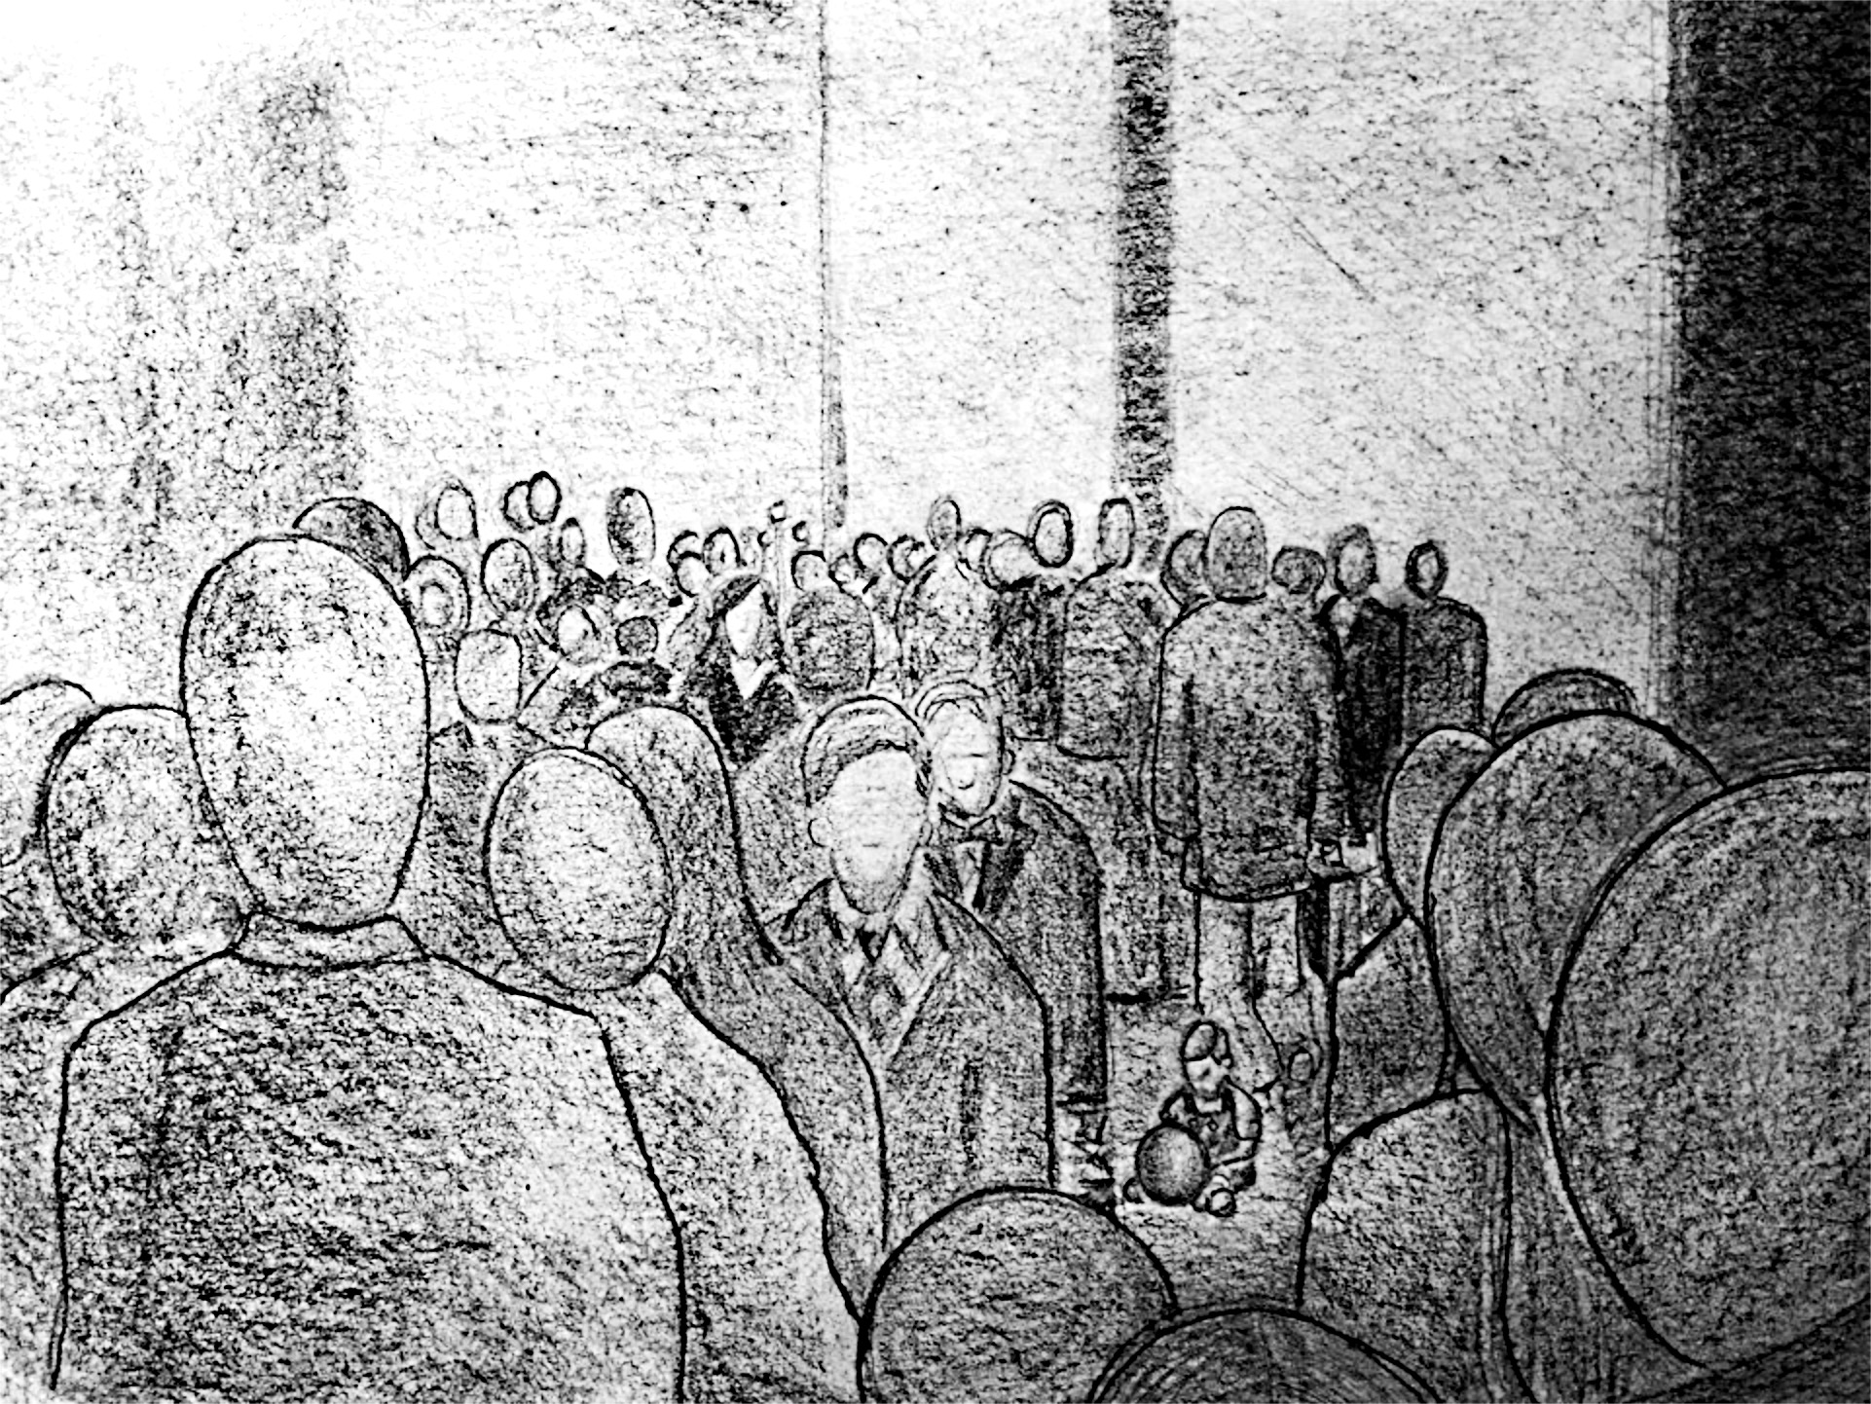

Slide 14
Assignment
Take time to ponder the “core pain” you feel
Describe it:
Label with a word description
Picture it… what does it look like
Describe it… feel, texture, smell, look, sound

