Slide 2
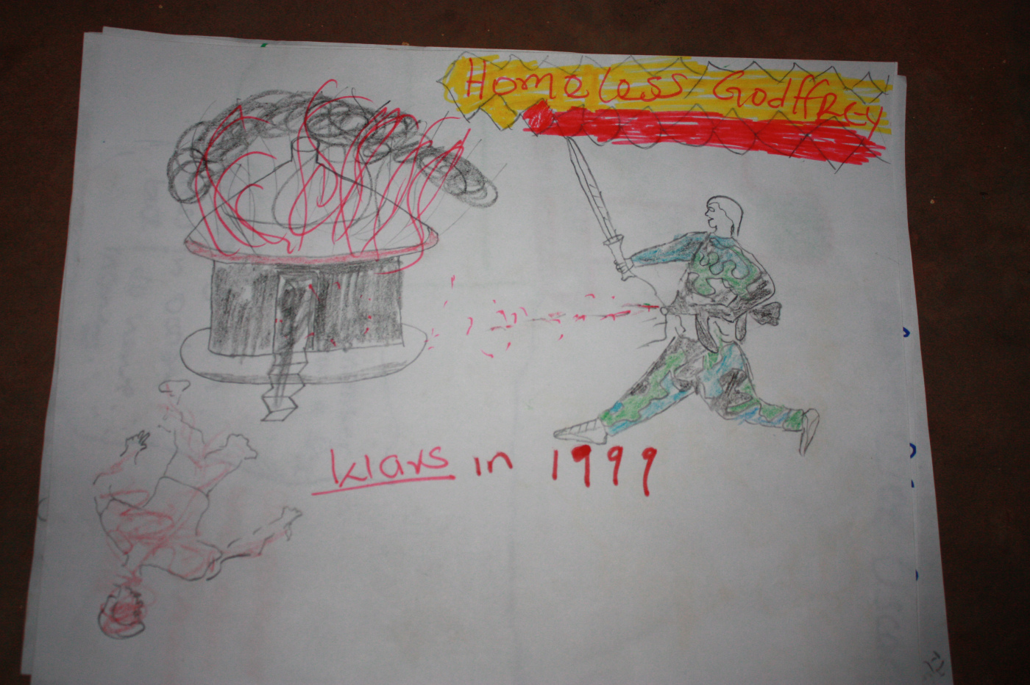

Slide 3
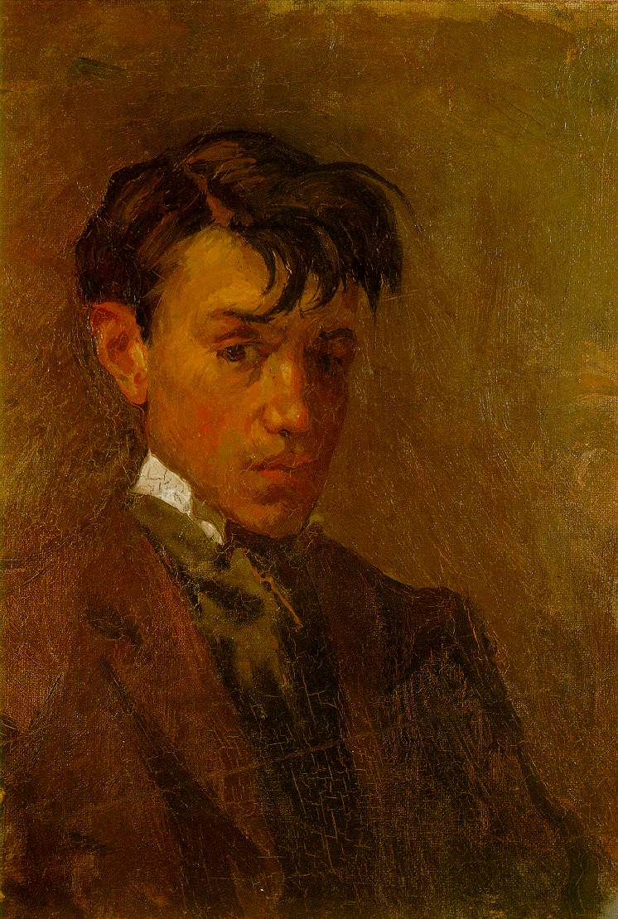

Slide 4
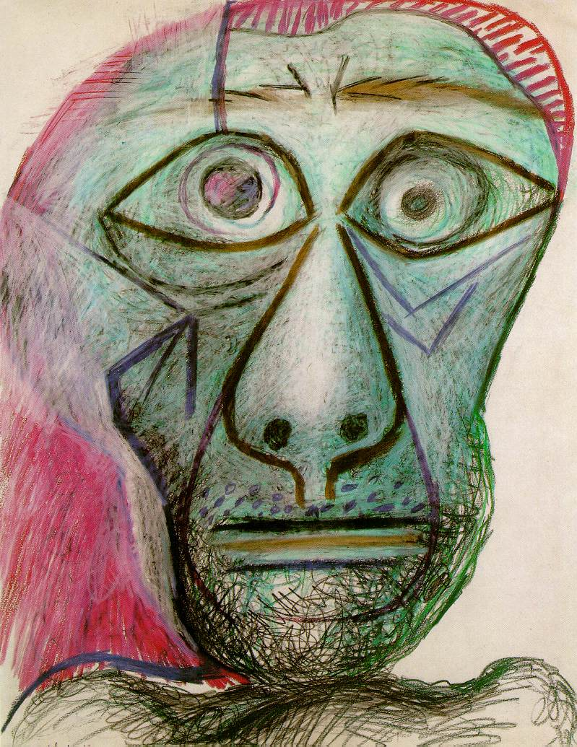

Slide 5
[Jesus] called a little child to him, and placed the child among them. And he said: “Truly I tell you, unless you change and become like little children, you will never enter the kingdom of heaven. Therefore, whoever takes the lowly position of this child is the greatest in the kingdom of heaven.”
Matthew 18:2-4 (NIV) emphasis added

Slide 6
Morning Pages
First thing in the morning
Handwritten, three pages
Stream of consciousness
Keep the pen/pencil moving

Slide 7
My Experience
Slow to flow (John 7:38)
Sludge (Matthew 12:34)
The voice of your “censor” (Mark 3:21)
The voice of your heart (Psalm 37:4)
The voice of God (John 10:3-5)
Notes:
John 7:38: “Whoever believes in me, as Scripture has said, rivers of living water will flow from within them.”
Matthew 12:34 “For the mouth speaks what the heart is full of.”
Mark 3:21: When his family heard about this, they went to take charge of him, for they said, “He is out of his mind.”
Psalm 37:4 Take delight in the Lord, and he will give you the desires of your heart.
John 10:3-5: The one who enters by the gate is the shepherd of the sheep. The gatekeeper opens the gate for him, and the sheep listen to his voice. He calls his own sheep by name and leads them out. When he has brought out all his own, he goes on ahead of them, and his sheep follow him because they know his voice. 5 But they will never follow a stranger; in fact, they will run away from him because they do not recognize a stranger’s voice.”

Slide 8
So Christ himself gave the apostles, the prophets, the evangelists, the pastors and teachers, to equip his people for works of service, so that the body of Christ may be built up until we all reach unity in the faith and in the knowledge of the Son of God and become mature, attaining to the whole measure of the fullness of Christ.
Then we will no longer be infants, tossed back and forth by the waves, and blown here and there by every wind of teaching and by the cunning and craftiness of people in their deceitful scheming. Instead, speaking the truth in love, we will grow to become in every respect the mature body of him who is the head, that is, Christ. From him the whole body, joined and held together by every supporting ligament, grows and builds itself up in love, as each part does its work.
Ephesians 4:11-15 (NIV) emphasis added

